Slide 1
Artificial Intelligence (AI)
Topic 1: Foundations of AI and Intelligent Agents (Part- III)

Slide 2
Agenda
Agent and Environments
Rationality
PEAS(Performance measure, Environment, Actuators, Sensors)
Agent Types
Learning Outcomes : Intelligent Agents
Methodology and Assessment Criteria for the Subject

Slide 3
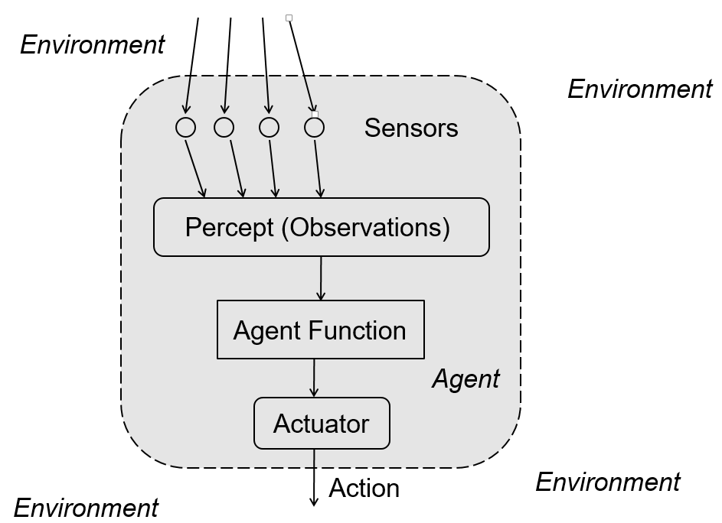

Slide 4
Task Environment
Task environments are the problems and rational agents are the solutions
Specifying the task environment
PEAS description as fully as possible
Performance
Environment
Actuators
Sensors
In designing an agent, the first step must always be to specify the task environment as fully as possible.

Slide 5
An Automated Taxi Driver (1)
Performance measure
How can we judge the automated driver?
Which factors are considered?
getting to the correct destination
minimizing fuel consumption
minimizing the trip time and/or cost
minimizing the violations of traffic laws
maximizing the safety and comfort, etc.

Slide 6
An Automated Taxi Driver (2)
Environment
A taxi must deal with a variety of roads
Traffic lights, other vehicles, pedestrians, stray animals, road works, police cars, etc.
Interact with the customer

Slide 7
An Automated Taxi Driver (3)
Actuators (for outputs)
Control over the accelerator, steering, gear shifting and braking
A display to communicate with the customers
Sensors (for inputs)
Detect other vehicles, road situations
GPS (Global Positioning System) to know where the taxi is
Many more devices are necessary

Slide 8
PEAS : Automated Taxi Driver
Agent Type | Performance Measure | Environment | Actuators | Sensors
Taxi | Safe, Fast, Legal, Comfortable trip, maximise profits | Roads, Pedestrians, Customers, other traffic | Steering, accelerator, break, signal horn, display | Cameras, Sonar, speedometer, odometer, GPS, Accelerometer, Engine Sensors, Keyboard

Slide 9
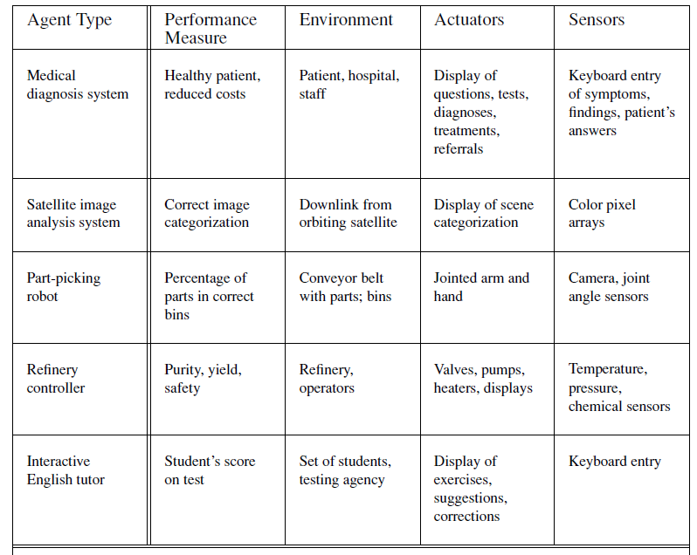
PEAS : Other Examples

Slide 10
Properties of Task Environments (1)
Fully observable vs. Partially observable
If an agent’s sensors give it access to the complete state of the environment at each point in time then the environment is effectively and fully observable
If the sensors detect all aspects
That are relevant to the choice of action
Partially observable
An environment might be Partially observable because of noisy and inaccurate sensors or because parts of the state are simply missing from the sensor data.
E.g.:
A local dirt sensor of the cleaner cannot tell
Whether other squares are clean or not

Slide 11
Properties of Task Environments (2)
Deterministic vs. stochastic
Next state of the environment completely determined by the current state and the actions executed by the agent, then the environment is deterministic, otherwise, it is Stochastic.
Strategic environment: deterministic except for actions of other agents
-Cleaner and taxi driver are:
Stochastic because of some unobservable aspects -> noise or unknown

Slide 12
Properties of Task Environments (2)
Deterministic vs. stochastic
Next state of the environment completely determined by the current state and the actions executed by the agent, then the environment is deterministic, otherwise, it is Stochastic.
Strategic environment: deterministic except for actions of other agents
-Cleaner and taxi driver are:
Stochastic because of some unobservable aspects -> noise or unknown

Slide 13
Properties of Task Environments (3)
Episodic vs. sequential
An episode = agent’s single pair of perception & action
The quality of the agent’s action does not depend on other episodes
Every episode is independent of each other
Episodic environment is simpler
The agent does not need to think ahead
Sequential
Current action may affect all future decisions
-Ex. Taxi driving and chess.

Slide 14
Properties of Task Environments (4)
Static vs. dynamic
A dynamic environment is always changing over time
E.g., the number of people in the street
While static environment
E.g., the destination
Semi dynamic
environment is not changed over time
but the agent’s performance score does

Slide 15
Properties of Task Environments (5)
Discrete vs. continuous
If there are a limited number of distinct states, clearly-defined percepts and actions, the environment is discrete
E.g., Chess game
Continuous: Taxi driving with different speed and location sweep through a continuous range of values over a period of time

Slide 16
Properties of Task Environments (6)
Known vs. unknown
This distinction refers not to the environment itself but to the agent’s (or designer’s) state of knowledge about the environment.
-In known environment, the outcomes for all actions are
given. ( E.g.: solitaire card games).
- If the environment is unknown, the agent will have to learn how it works in order to make good decisions(E.g.: new video game).

Slide 17
Properties of Task Environments (7)
Single Agent vs Multi Agent
- Playing a crossword puzzle – single agent
- Chess playing – two agents
-Competitive Multi Agent environment
Chess playing
-Cooperative Multi Agent environment
Automated taxi driver
Avoiding collision
Note:
In a Multi Agent Environment communication between agents describe its rationality while considering agent designing problems
We will need Environment class with specific properties to run an agent with the Environment generator (E.g. Simulating Environment for Taxi Driving)

Slide 18
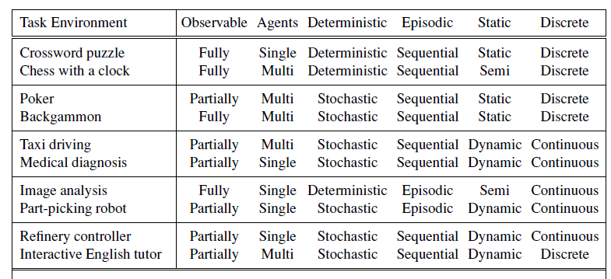
Examples of Task Environments

Slide 19
Solution from yesterday’s class
A File Manager Agent
Sensors:
File Explorer
Actuators:
Commands like Winzip , WinRAR.
Purpose:
Compress and archive files that have not been used in a while.
Environment:
Fully observable (but partially observed), deterministic (strategic), episodic, dynamic, discrete

Slide 20
Learning Outcomes with the Topic
Understanding of Task Environments
Designing an Agent

Slide 21
Methodology And Assessment Criterias
Class Assignment(s)
Each chapter being covered will have one assignment. The Case Studies will be given in line to the Changing with Speed across IT Projects in Kirirom
Internal Exam(s)
There will be 2 exams
Model Exam
There will be one Model Exam.
Semester Exam
There will be 1 Semester Exam

Slide 22
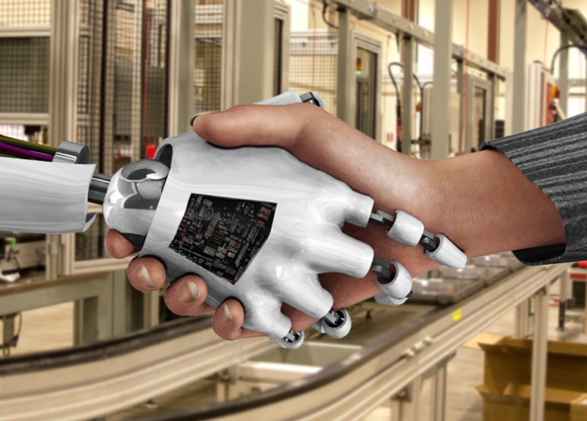
Thank You !
“Maybe the only significant difference between a really smart simulation and a human being was the noise they made when you punched them.”
-Terry Pratchett, The Long Earth

